Slide 1
Data Structures and Algorithms
**Slide and animations taken from other ppts are referred

Slide 2
Teaching Faculty
Venkatesh Chopella (Labs)
Lini Thomas (Lectures First Half)
Kshitij Gajjar (Lectures Second Half)

Slide 3
Grading
Labs 20 marks (Feb-April: best 5 of 10 labs approx)
Assignment: 10 marks (5 assignments)
Mid lab + End lab: 10+ 15
Quiz2: 10
Mid exam: 12
End exam: 20
Slip tests: 3

Slide 4
Joining the dots
Algorithm: Steps to be taken on the input inorder to produce a desired output. An efficient algorithm takes less time and less memory.
Program: Writing out the algorithm in some particular programming language.
Data structure: Storing the data in a manner that the steps of the algorithm are most benefitted

Slide 5
The Sorting Problem
Input:
  A sequence of n numbers a₁, a₂, . . . , a_{n}
Output:
  A permutation (reordering) a₁’, a₂’, . . . , a_{n}’ of the input sequence such that a₁’ ≤ a₂’ ≤ · · · ≤ a_{n}’

Slide 6
Sorting
Sorting takes an unordered collection and makes it an ordered one.
1 2 3 4 5 6
77
42
35
12
101
5
1 2 3 4 5 6
5
12
35
42
77
101

Slide 7
Some Definitions
Internal Sort
  The data to be sorted is all stored in the computer’s main memory.
External Sort
  Some of the data to be sorted might be stored in some external, slower, device.
In Place Sort
  The amount of extra space required to sort the data is constant with the input size.

Slide 8
Insertion Sort
Making room to insert the card
To insert 12, we need to make room for it by moving first 36 and then 24.
6
10
24
36
12
www.cse.unr.edu/~bebis/.../InsertionSortBubbleSortSelectionSort.ppt

Slide 9
Insertion Sort
6
10
24
36
12

Slide 10
Insertion Sort
6
10
24
36
12

Slide 11

Insertion Sort
input array
5 2 4 6 1 3
at each iteration, the array is divided in two sub-arrays:
left sub-array
right sub-array
sorted
unsorted

Slide 12
Insertion Sort

Slide 13
INSERTION-SORT
Alg.: INSERTION-SORT(A)
for j ← 2 to n
do key ← A[ j ]
Insert A[ j ] into the sorted sequence A[1 . . j -1]
i ← j - 1
while i > 0 and A[i] > key
do A[i + 1] ← A[i]
i ← i – 1
A[i + 1] ← key
Insertion sort – sorts the elements in place
1
2
3
4
5
6
7
8
a₁
a₂
a₃
a₄
a₅
a₆
a₇
a₈
key

Slide 14
INSERTION SORT USING FOR
for(int i=1;i<7;i++)
{int temp=A[i];
for(int j=i-1;j>=0;j--)
{
if(A[j]>temp)
{ A[j+1]=A[j];
if(j==0)A[0]=temp;
}
else {A[j+1]=temp; break;}
}
}

Slide 15
Complexity ?
Best case :
Worst case:
Extra space:

Slide 16
Best case : O(n)
Worst case: O(n²)
Extra space: Constant

Slide 17
Binary Search
int binarySearch(int arr[], int low, int high, int x)
{
while (low <= high) {
int mid = low + (high - low) / 2;
if (arr[mid] == x) return mid;
if (arr[mid] < x) low = mid + 1;
else
high = mid - 1;
}
return -1; //element not present
}

Slide 18
Questions
Can binary search to find the right place to insert the next item help us better sort an array of integers?
In a permutation a1.....an of n distinct integers, an inversion is a pair (ai, aj) such that i < j and ai > aj. What is the relation between insertion sort and inversions if the number of inversions is f(n) ?

Slide 19
Bubble Sort
Bubbling up the largest element each time
www.cc.gatech.edu/~bleahy/cs1311/cs1311lecture16wdl.ppt

Slide 20
"Bubbling Up" the Largest Element
  “Bubble” the largest value to the end using pair-wise comparisons and swapping
1 2 3 4 5 6
77
42
35
12
101
5

Slide 21
"Bubbling Up" the Largest Element
Traverse a collection of elements
  Move from the front to the end
  “Bubble” the largest value to the end using pair-wise comparisons and swapping
Swap
1 2 3 4 5 6
42
77
77
42
35
12
101
5

Slide 22
"Bubbling Up" the Largest Element
Traverse a collection of elements
  Move from the front to the end
  “Bubble” the largest value to the end using pair-wise comparisons and swapping
1 2 3 4 5 6
Swap
35
77
42
77
35
12
101
5

Slide 23
"Bubbling Up" the Largest Element
Traverse a collection of elements
  Move from the front to the end
  “Bubble” the largest value to the end using pair-wise comparisons and swapping
1 2 3 4 5 6
Swap
12
77
42
35
77
12
101
5

Slide 24
"Bubbling Up" the Largest Element
Traverse a collection of elements
  Move from the front to the end
  “Bubble” the largest value to the end using pair-wise comparisons and swapping
1 2 3 4 5 6
42
35
12
77
101
5
No need to swap

Slide 25
"Bubbling Up" the Largest Element
Traverse a collection of elements
  Move from the front to the end
  “Bubble” the largest value to the end using pair-wise comparisons and swapping
1 2 3 4 5 6
Swap
5
101
42
35
12
77
101
5

Slide 26
Bubble sort algorithms
void bubbleSort(int arr[], int n)
{ int i, j;
for (i = 0; i < n-1; i++) // Last i elements are already in place
for (j = 0; j < n-i-1; j++)
if (arr[j] > arr[j+1])
swap(&arr[j], &arr[j+1]);
}
Best case : O(n)
Worst case: O(n²)
Extra space: Constant

Slide 27
How can we optimise Bubble sort ?

Slide 28
Using a Boolean “Flag”
We can use a boolean variable to determine if any swapping occurred during the “bubble up.”
If no swapping occurred, then we know that the collection is already sorted!
This boolean “flag” needs to be reset after each “bubble up.”

Slide 29
Summary
“Bubble Up” algorithm will move largest value to its correct location (to the right)
Repeat “Bubble Up” until all elements are correctly placed:
  Maximum of N-1 times
  Can finish early if no swapping occurs
We reduce the number of elements we compare each time one is correctly placed

Slide 30
Selection Sort
Select the maximum each time
https://www.student.cs.uwaterloo.ca/~cs126/Tutorials/.../SelectionSort.ppt

Slide 31
Selection Sort
5 | 1 | 3 | 4 | 6 | 2
Comparison
Data Movement
Sorted

Slide 32
Selection Sort
5 | 1 | 3 | 4 | 6 | 2
Comparison
Data Movement
Sorted

Slide 33
Selection Sort
5 | 1 | 3 | 4 | 6 | 2
Comparison
Data Movement
Sorted

Slide 34
Selection Sort
5 | 1 | 3 | 4 | 6 | 2
Comparison
Data Movement
Sorted

Slide 35
Selection Sort
5 | 1 | 3 | 4 | 6 | 2
Comparison
Data Movement
Sorted

Slide 36
Selection Sort
5 | 1 | 3 | 4 | 6 | 2
Comparison
Data Movement
Sorted

Slide 37
Selection Sort
5 | 1 | 3 | 4 | 6 | 2
Comparison
Data Movement
Sorted

Slide 38
Selection Sort
5 | 1 | 3 | 4 | 6 | 2
•
Largest
Comparison
Data Movement
Sorted

Slide 39
Selection Sort
5 | 1 | 3 | 4 | 2 | 6
Comparison
Data Movement
Sorted

Slide 40
Selection Sort
5 | 1 | 3 | 4 | 2 | 6
Comparison
Data Movement
Sorted

Slide 41
Selection Sort
5 | 1 | 3 | 4 | 2 | 6
Comparison
Data Movement
Sorted

Slide 42
Selection Sort
5 | 1 | 3 | 4 | 2 | 6
Comparison
Data Movement
Sorted

Slide 43
Selection Sort
5 | 1 | 3 | 4 | 2 | 6
Comparison
Data Movement
Sorted

Slide 44
Selection Sort
5 | 1 | 3 | 4 | 2 | 6
Comparison
Data Movement
Sorted

Slide 45
Selection Sort
5 | 1 | 3 | 4 | 2 | 6
Comparison
Data Movement
Sorted

Slide 46
Selection Sort
5 | 1 | 3 | 4 | 2 | 6
•
Largest
Comparison
Data Movement
Sorted

Slide 47
Selection Sort
2 | 1 | 3 | 4 | 5 | 6
Comparison
Data Movement
Sorted

Slide 48
Selection Sort
2 | 1 | 3 | 4 | 5 | 6
Comparison
Data Movement
Sorted

Slide 49
Selection Sort
2 | 1 | 3 | 4 | 5 | 6
Comparison
Data Movement
Sorted

Slide 50
Selection Sort
2 | 1 | 3 | 4 | 5 | 6
Comparison
Data Movement
Sorted

Slide 51
Selection Sort
2 | 1 | 3 | 4 | 5 | 6
Comparison
Data Movement
Sorted

Slide 52
Selection Sort
2 | 1 | 3 | 4 | 5 | 6
Comparison
Data Movement
Sorted

Slide 53
Selection Sort
2 | 1 | 3 | 4 | 5 | 6
•
Largest
Comparison
Data Movement
Sorted

Slide 54
Selection Sort
2 | 1 | 3 | 4 | 5 | 6
Comparison
Data Movement
Sorted

Slide 55
Selection Sort
2 | 1 | 3 | 4 | 5 | 6
Comparison
Data Movement
Sorted

Slide 56
Selection Sort
2 | 1 | 3 | 4 | 5 | 6
Comparison
Data Movement
Sorted

Slide 57
Selection Sort
2 | 1 | 3 | 4 | 5 | 6
Comparison
Data Movement
Sorted

Slide 58
Selection Sort
2 | 1 | 3 | 4 | 5 | 6
Comparison
Data Movement
Sorted

Slide 59
Selection Sort
2 | 1 | 3 | 4 | 5 | 6
•
Largest
Comparison
Data Movement
Sorted

Slide 60
Selection Sort
2 | 1 | 3 | 4 | 5 | 6
Comparison
Data Movement
Sorted

Slide 61
Selection Sort
2 | 1 | 3 | 4 | 5 | 6
Comparison
Data Movement
Sorted

Slide 62
Selection Sort
2 | 1 | 3 | 4 | 5 | 6
Comparison
Data Movement
Sorted

Slide 63
Selection Sort
2 | 1 | 3 | 4 | 5 | 6
Comparison
Data Movement
Sorted

Slide 64
Selection Sort
2 | 1 | 3 | 4 | 5 | 6
•
Largest
Comparison
Data Movement
Sorted

Slide 65
Selection Sort
1 | 2 | 3 | 4 | 5 | 6
Comparison
Data Movement
Sorted

Slide 66
Selection Sort
1 | 2 | 3 | 4 | 5 | 6
DONE!
Comparison
Data Movement
Sorted

Slide 67
Pseudocode of Selection Sort
1. for j ← 1 to n-1
2. smallest ← j
3. for i ← j + 1 to n
4. if A[ i ] < A[ smallest ]
5. smallest ← i
6. Exchange A[ j ] ↔ A[ smallest ]
Idea:
Finds the largest element in the array.
Exchange largest element with element at last position.
Find the second largest element and exchange with the element at the second largest position.
This process continues until the complete array is sorted.
Swaps minimum. Best and worst takes O(n²)

Slide 68
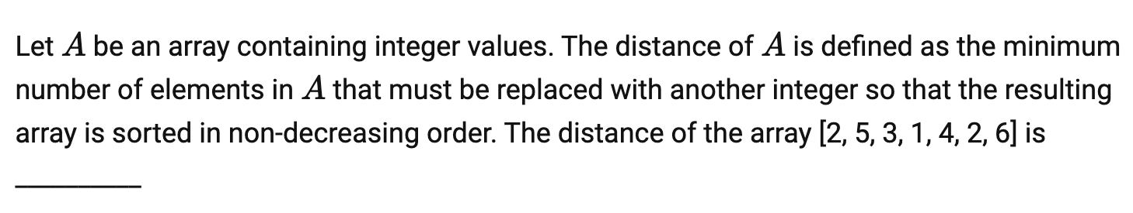
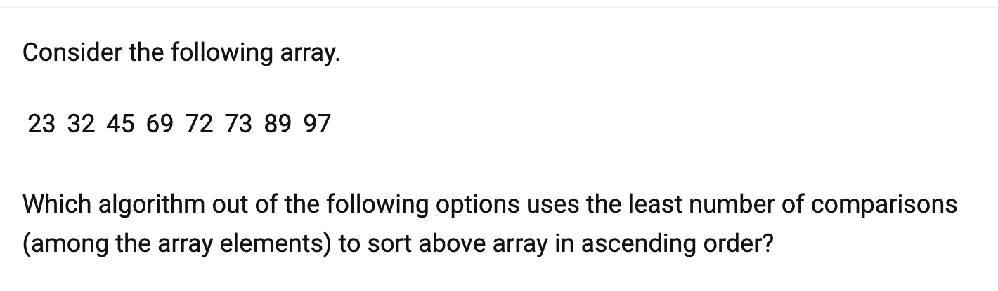
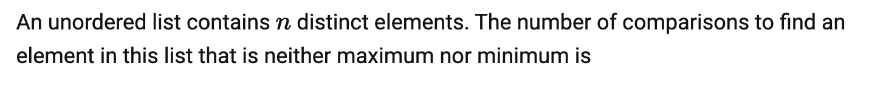

Slide 69
Ans: 3 (can figure out using selection sort)
Ans: insertion sort
Ans: O(1). Check first three elements. Among them what is not max or min is the ans

Slide 70
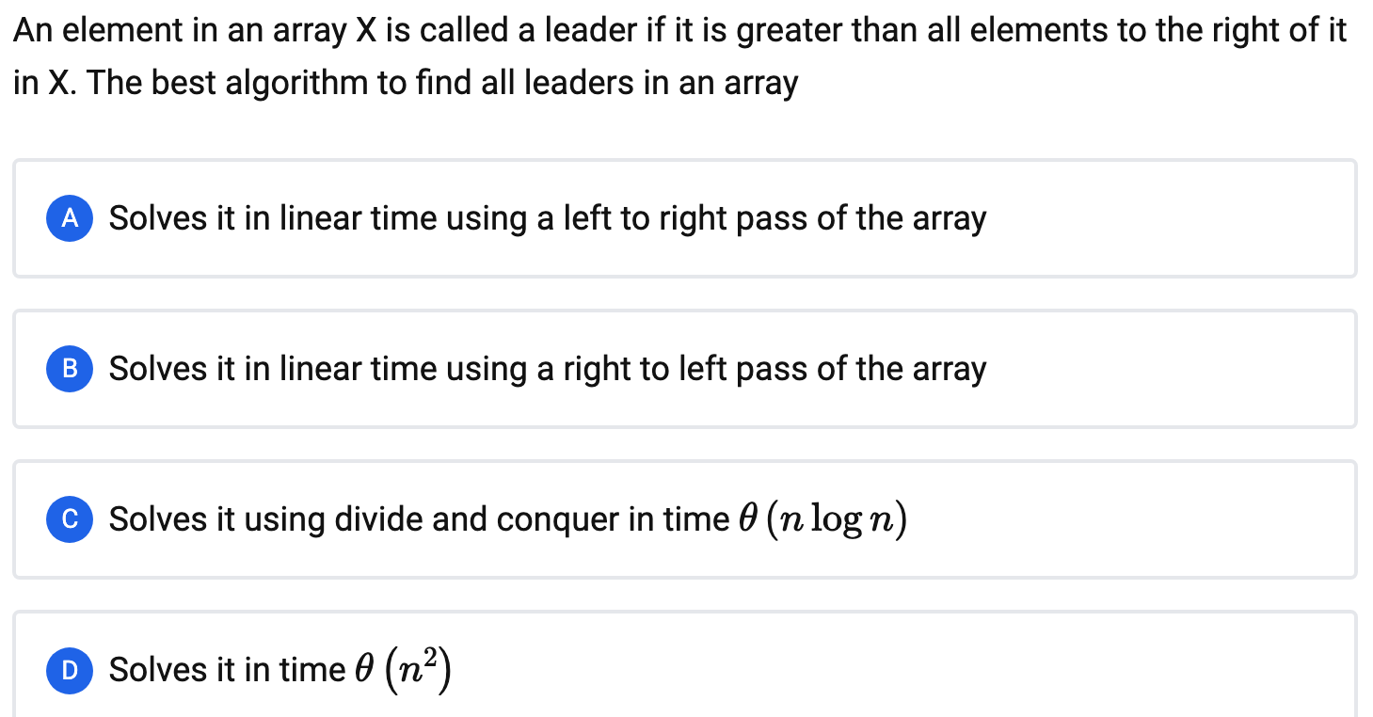

Slide 71
Ans: B

Slide 72
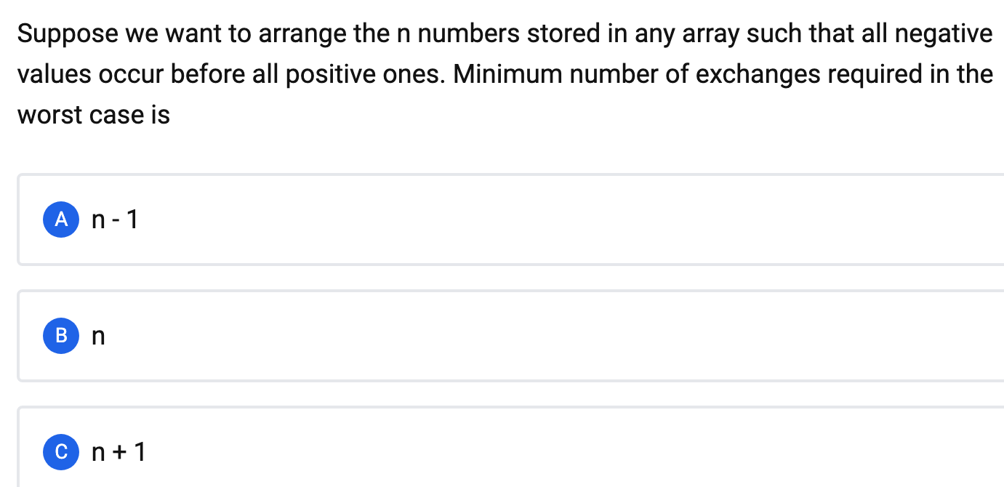

Slide 73
Ans: None of the above. Can be done in n/2 exchanges.
Two pointers at either ends. Right pointer scans for negative number and left for
positive. Swap when they find their numbers. Stop when pointers exchange

Slide 74
Which algorithm would you use
Minimise writes
Minimise swaps
Almost sorted

Slide 75
Minimise writes—selection sort
Minimise swaps – selection sort
Almost sorted – insertion sort

Slide 76
Homework Questions
Implement Binary Search
Implement Insertion Sort
Implement Selection Sort
Implement Bubble Sort optimised

